Slide 1


Slide 2
How to build the network in a career

Slide 3
What is Network?

Slide 4


You think…..
vs

Slide 5
How to build the network in a career
Content:
I. Value of network in a career
II. Process to build
III. Rule: Know, Like and Truth IV. Conclusion and Q&A

Slide 6

I. Value of network in a career

Slide 7
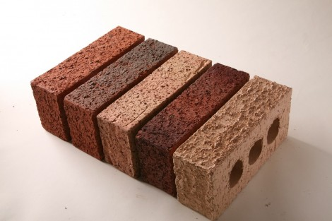
I. Value of network in a career

Slide 8

I. Value of network in a career

Slide 9
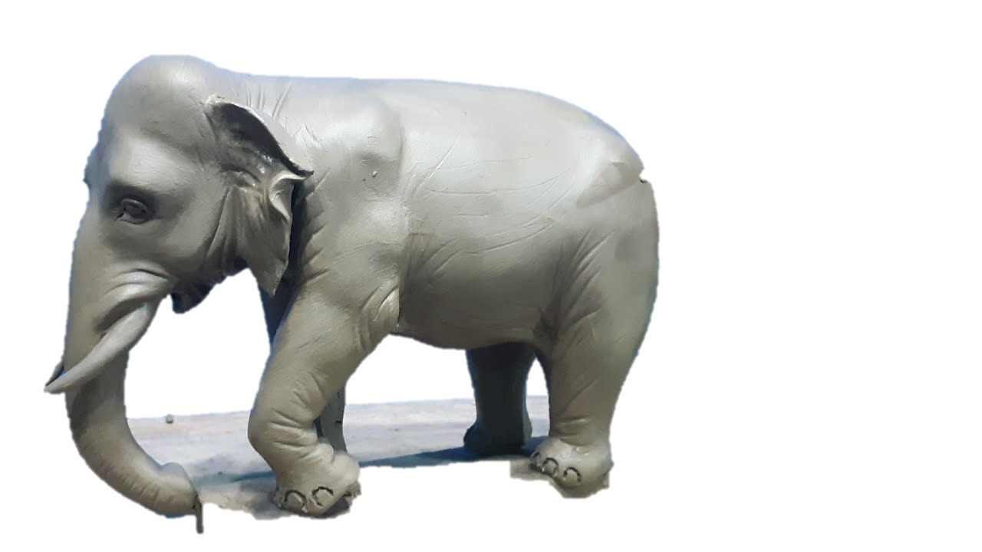
I. Value of network in a career

Slide 10

I. Value of network in a career
1. Get career advice and support

Slide 11

I. Value of network in a career
2. Get fresh ideas

Slide 12

I. Value of network in a career
3. Confidence building

Slide 13

I. Value of network in a career
4. Develop lasting relationships

Slide 14

I. Value of network in a career
5. Collaboration

Slide 15

I. Value of network in a career
6. Become a Leader or Manager in an organization

Slide 16

II. Process to build

Slide 17

II. Process to build
1. First impression

Slide 18

Create a story to talk

Slide 19


II. Process to build
2. Self-introduction and 1-minute hook

Slide 20

II. Process to build
2. Self-introduction and 1-minute hook

Slide 21

Power of 60 seconds
Introduction: Name, organization, & Profession
2. Share a Single: Introduce ONE specific skill your profession to discuss
3. Tell your Story: How you helped those customers
4. Call to Action: List your specific referral request
5. The Close: Repeat your name and origination

Slide 22

Power of 60 seconds
Hello Excellency, Lady, and gentleman!
I’m Chan Voleak, a 2nd-year student in PNC my major is Andriod Development. I have completed 10 projects with my team during my study.
Now I help my team to achieve 5 projects with Android Development
If Excellency, Lady, and gentleman, who have these concerns about these Projects or you have friends looking us to help please contact me after this meeting.
I’m Chan Voleak from PNC
Thank you!!!

Slide 23

3. Give name card

Slide 24

4. Eye contact

Slide 25

5. Active Listening

Slide 26

6. Conversation Style
1-1

Slide 27

6. Conversation Style
1-2

Slide 28

6. Conversation Style
1-group

Slide 29

Networking time not Eating Time

Slide 30

Keep in Touch and one-to-one
Not over 48 hours !!!

Slide 31

III. Rule: Know, Like and Truth

Slide 32

III. Rule: Know, Like and Truth
1. Know

Slide 33

III. Rule: Know, Like and Truth
2. Like

Slide 34

III. Rule: Know, Like and Truth
3. Trust

Slide 35

IV. Conclusion and Q&A

